Slide 1
A futuristic, cloud based, AI driven platform which procures content for cash rewards and then monetises it.
Presented By Shred Pillai, C E O

Slide 2
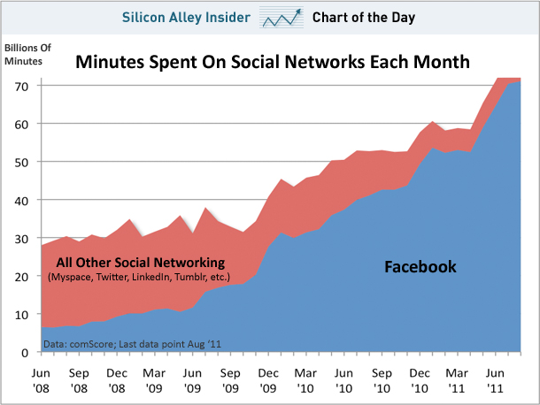
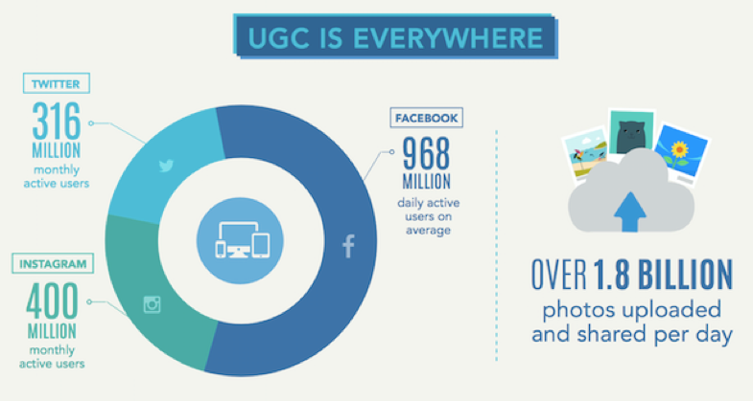
Disruptive venture which rewards users of social media for their time & content

Slide 3
A mobile app which hides a big social network which rewards members in cash
Social Networking platform to Include IOT, AI (devices, robots on internet)
Biometric Login/Identity Security
Content Protection
Content Moderation
Content Valuation and Marketing
Essential User Services
Real life community building

Slide 4
An app liked by 30% Facebookers who like to receive cash for their posts & likes

Slide 5
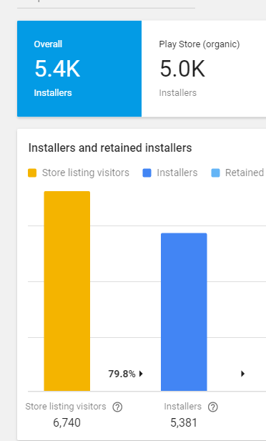
A viral demand confirmed by 6000 users who installed in a single day!

Slide 6
A powerful self financing platform
Paybookclub App
Paybook. club Website
Members Register
SEO + Corporate Buyers Register
Members Post Content & share
Free Share
Get Free Content (Blue Button )
Other Members Monetize
Paid Keyword Match
Get Live Paid SEO Content
Get Paid For Content & Likes
Paybookclub Money Pool
Pay From Ad Budget
Buy Paid PBC Services
Buy Corporate Services
PAYBOOKCLUB
MEMBER SERVICES
PAYBBOKCLUB CORPORATE SERVICES

Slide 7
A unique platform which generates revenue from multiple channels
Direct sale of content
Content Monetizing to websites
Content marketing
Subscription services
Third party advertising…….
and many others
Full length movies

Slide 8
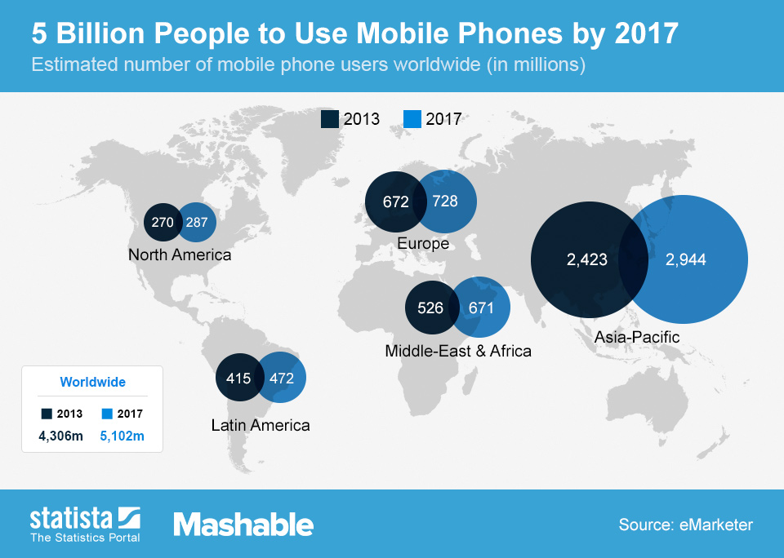
A scalable technology venture which will run on billions of mobile phones

Slide 9
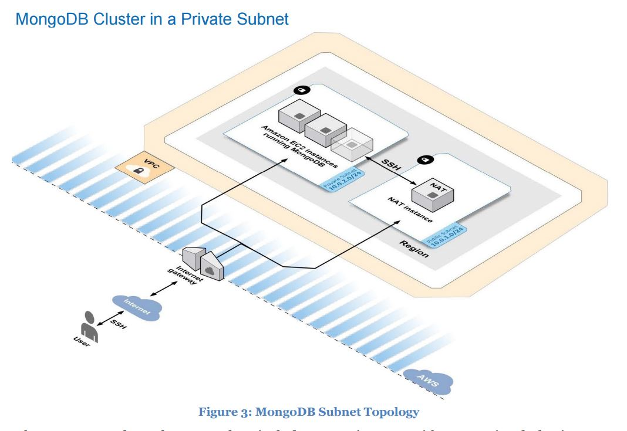
A cloud based elastic infra structure which scales to billions of users
Amazon Web Services Hosting
Mongo DB – Object Database
Node JS API
Big Data for analytics
IOT (Internet of Things)
AI (artificial Intelligence)
Latest Mobile Frameworks

Slide 10
Net Income – Paybookclub Profits = Members Rewards
A business in which profits come first and a venture which will exit fast!

Slide 11
Paybookclub A Unicorn By 2020 5 Years Financial Projection
 | 2017 | 2018 | 2019 | 2020 | 2021
App Installs | 12,000 (actual) | 3,000,000 (projected) | 10,000,000 | 40,000,000 | 100,000,000
Active users | 1000 | 1,500,000 | 5,000,000 | 25,000,000 | 50,000,000
Posts Per Year | 4000 | 6,000,000 | 20,000,000 | 240,000,000 | 600,000,000
Revenue $ (Content sales + Services) | 85,000 | 2,363,500 | 33,220,000 | 691,040,000 | 1,511,670,000
Expenses $ | 3,524,000 | 18,168,500 | 25,769,000 | 303,115,000 | 601,975,000
EBITDA | -3,439,000 | -15,805,000 | 7,451,000 | 387,925,000 | 909,695,000
Return On Investment % | 0 | -451 | -58 | 3630 | 9240

Slide 12
Great Angel and VC Funding Opportunity
Asking $3,000,000 for 20% of Paybookclub
In exchange of SAFEs
(Simple Agreement for Equity
in smaller partial amounts)
To achieve a Milestone Target of
Adding 1 Million users and reaching break even of business in 2 years.

Slide 13
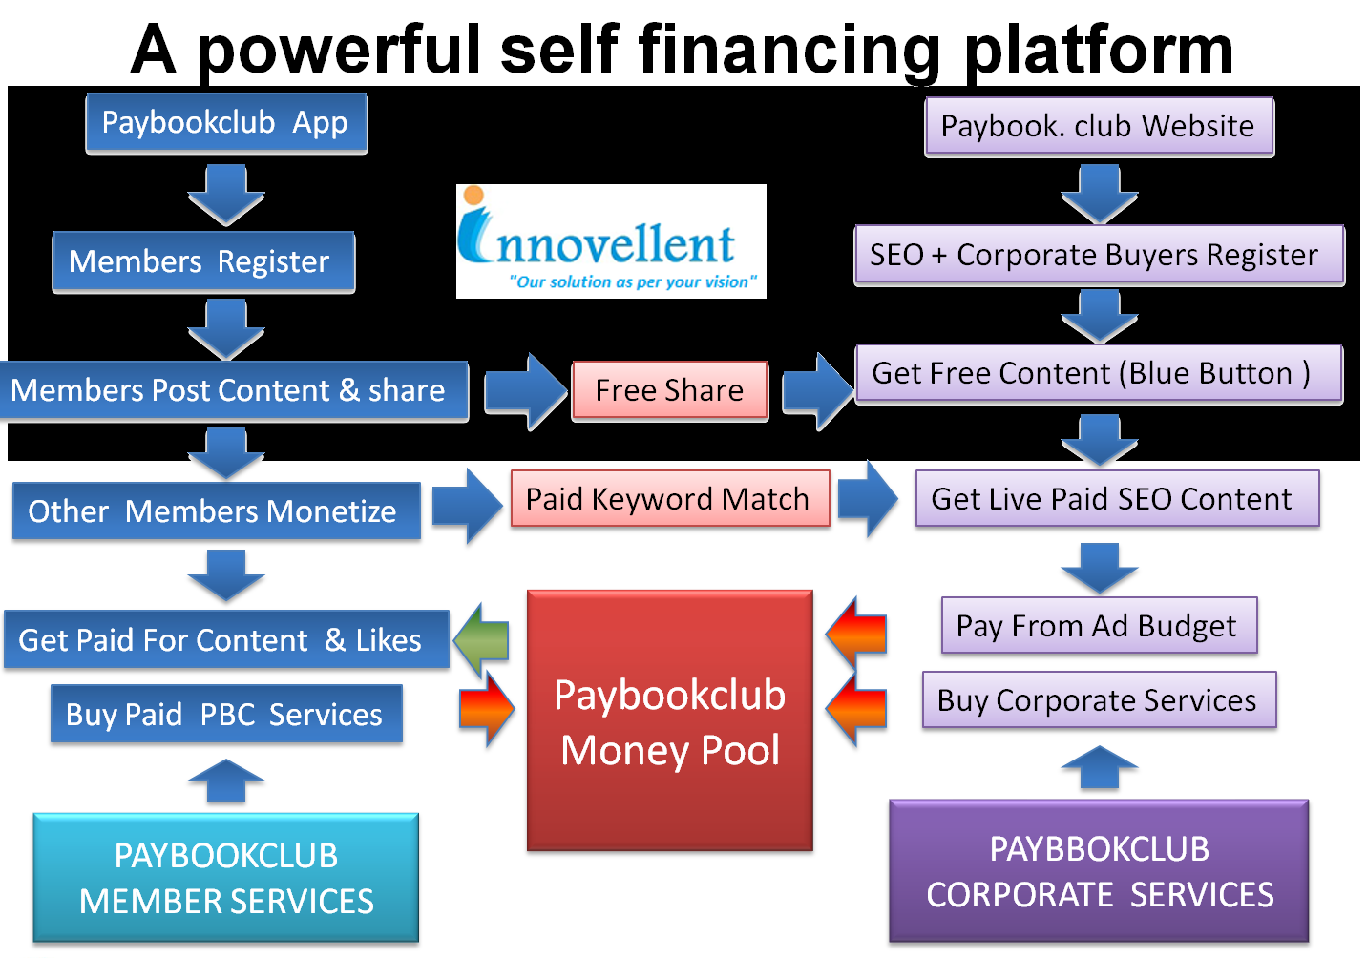
Investment in Paybookclub so far
Project started - Jan 2016
Burn Rate - £5000/month
Total spend ~ £100,000
Software development (Bangalore)
Ad Runs ( Facebook, Google, Twitter)
Press meet (Kochi, Chennai, Bangalore)
Angel & Private Investors (K4 Socal, Europe, Hong Kong)
Direct member enlisting (Chennai, Bangalore)
Print and promotional material

Slide 14
Allocation of Funding
The funds will be used for:
Software Development $600,000
Membership building $2,000,000
Admin and Support $400,000

Slide 15
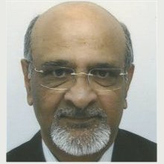
Paybookclub Pioneering Team
Sreedhar Pillai
CEO Capexsales Ltd
Amit Verma
Co Founder &CEO
Innovellent Technologies Ltd
Anand Gourab
Co Founder & Head Of Marketing
Innovellent Technologies Ltd
Santhosh Singh
CTO
Innovellent Technologies Ltd

Slide 16
Best investment opportunity in 2017
World’s Content Marketplace
by 2020.

